Slide 1




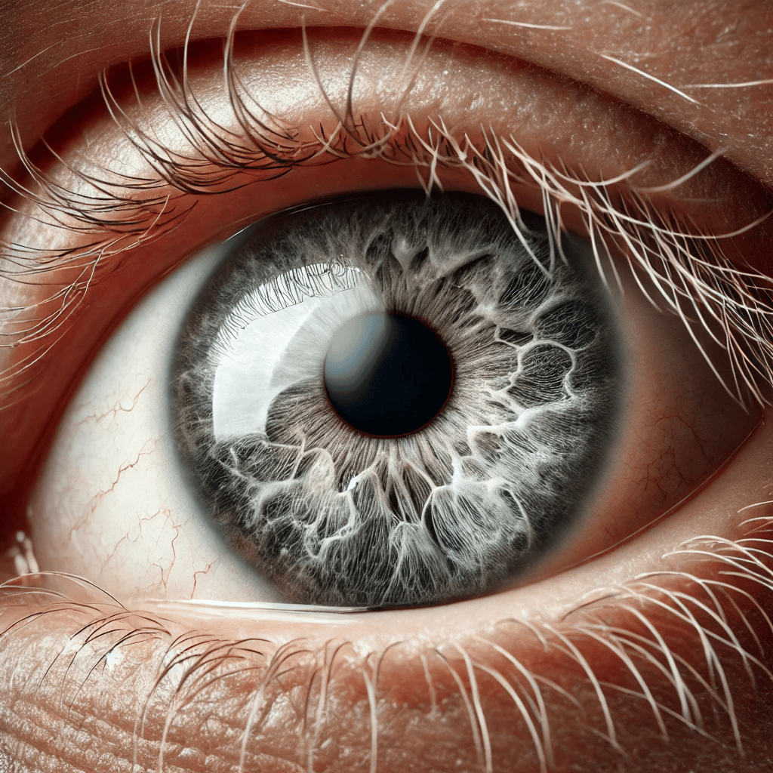
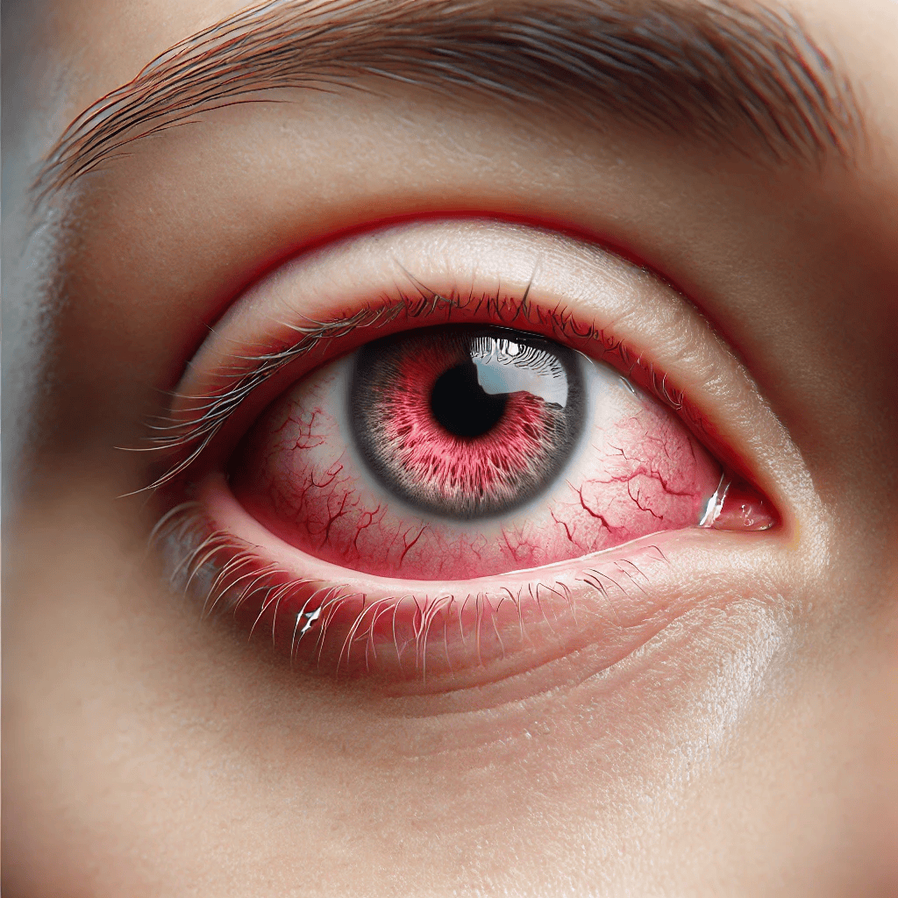
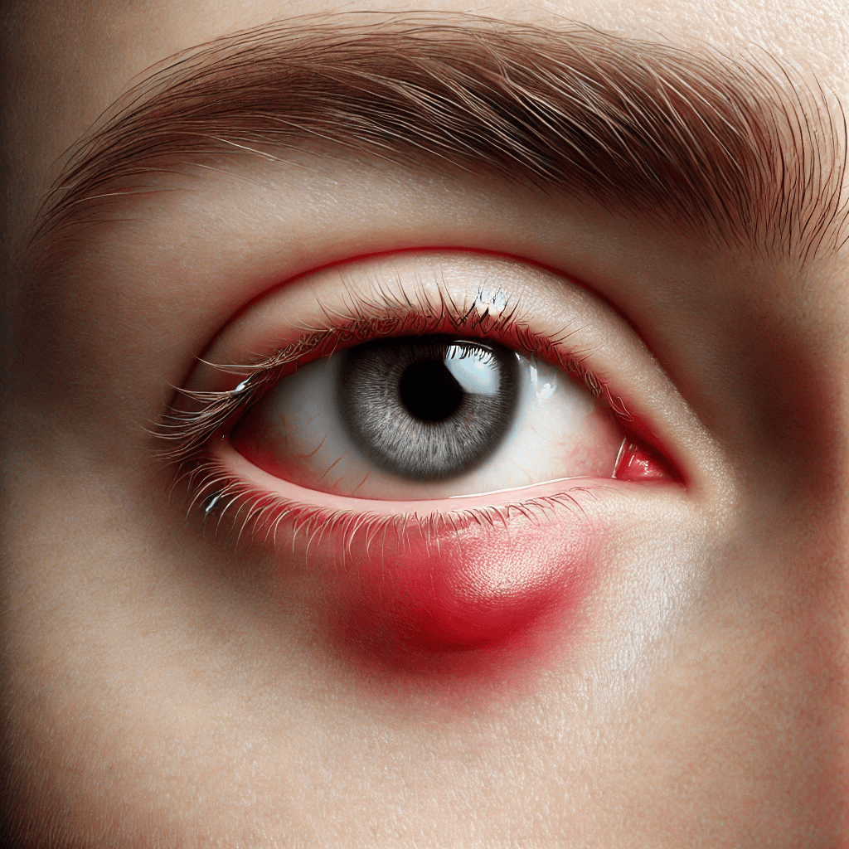



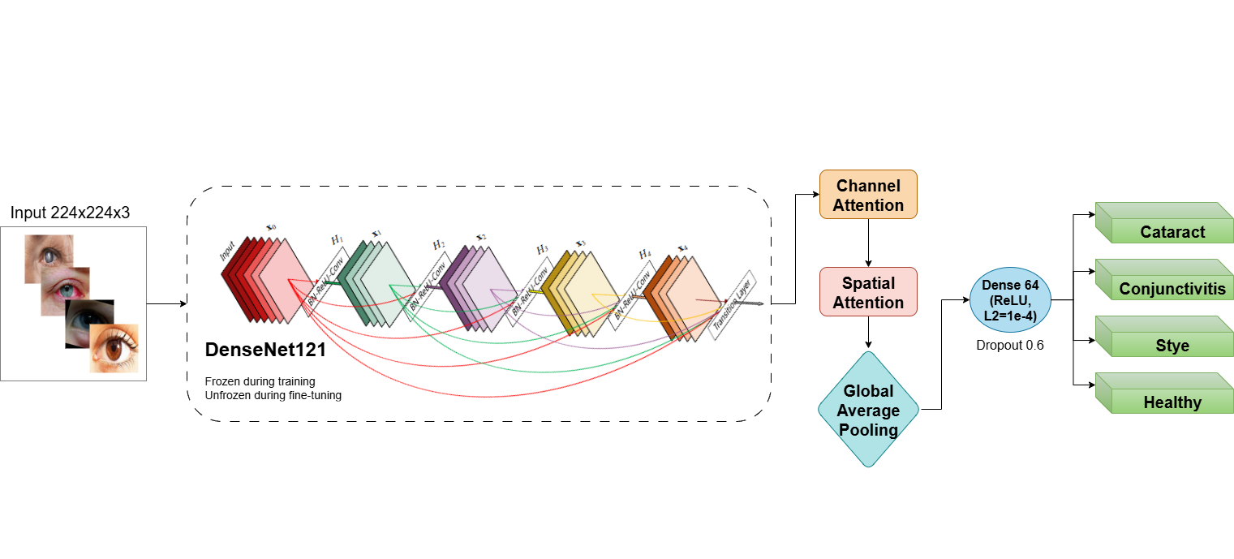
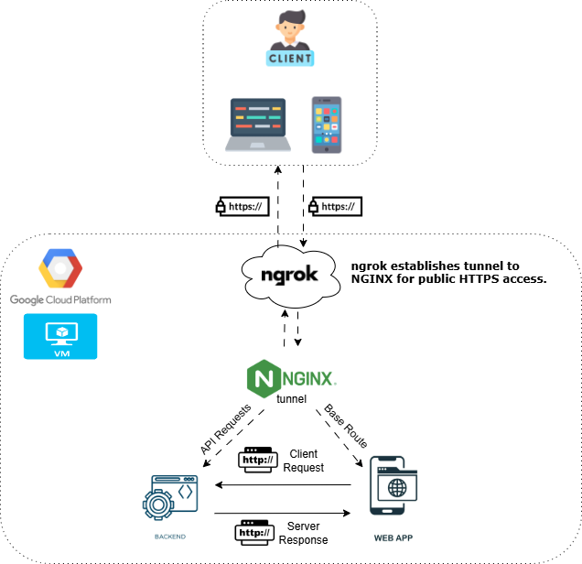

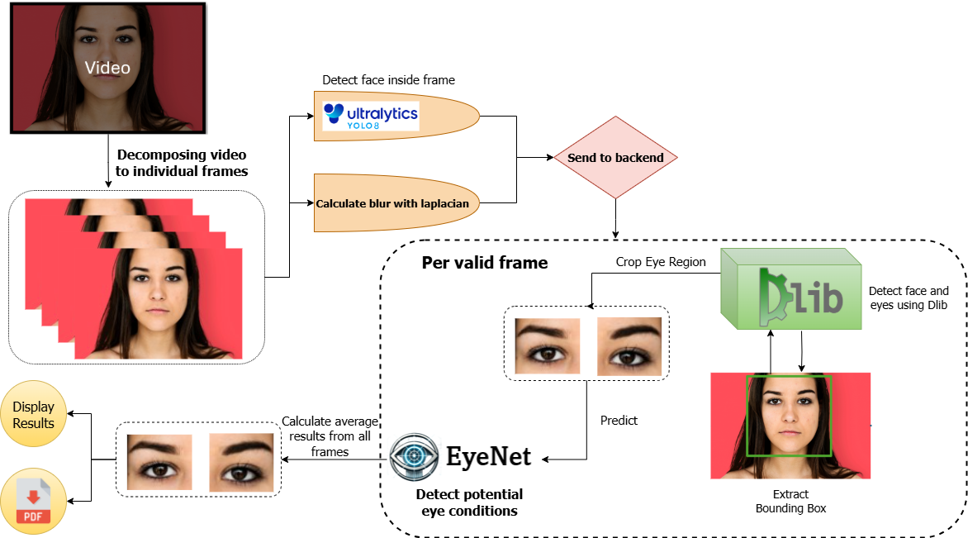
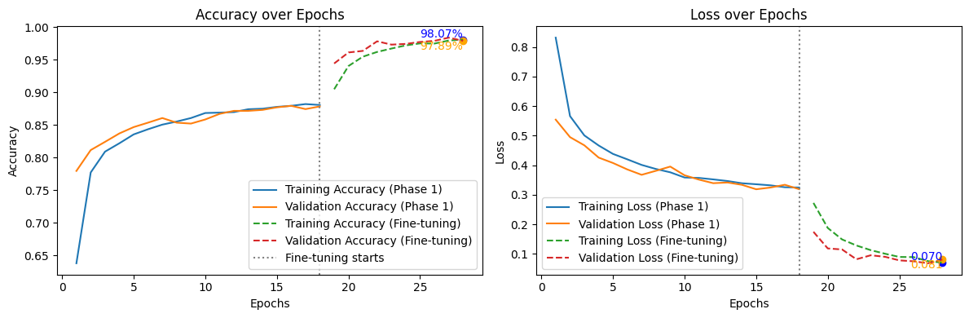
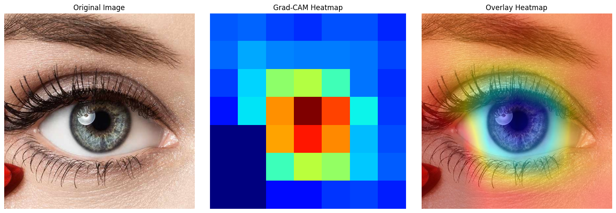
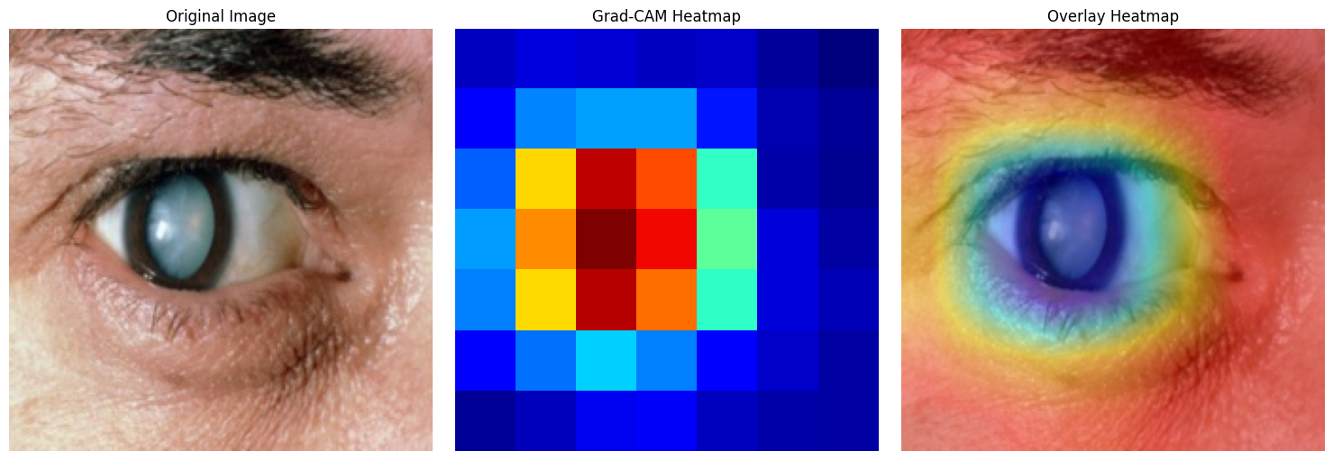
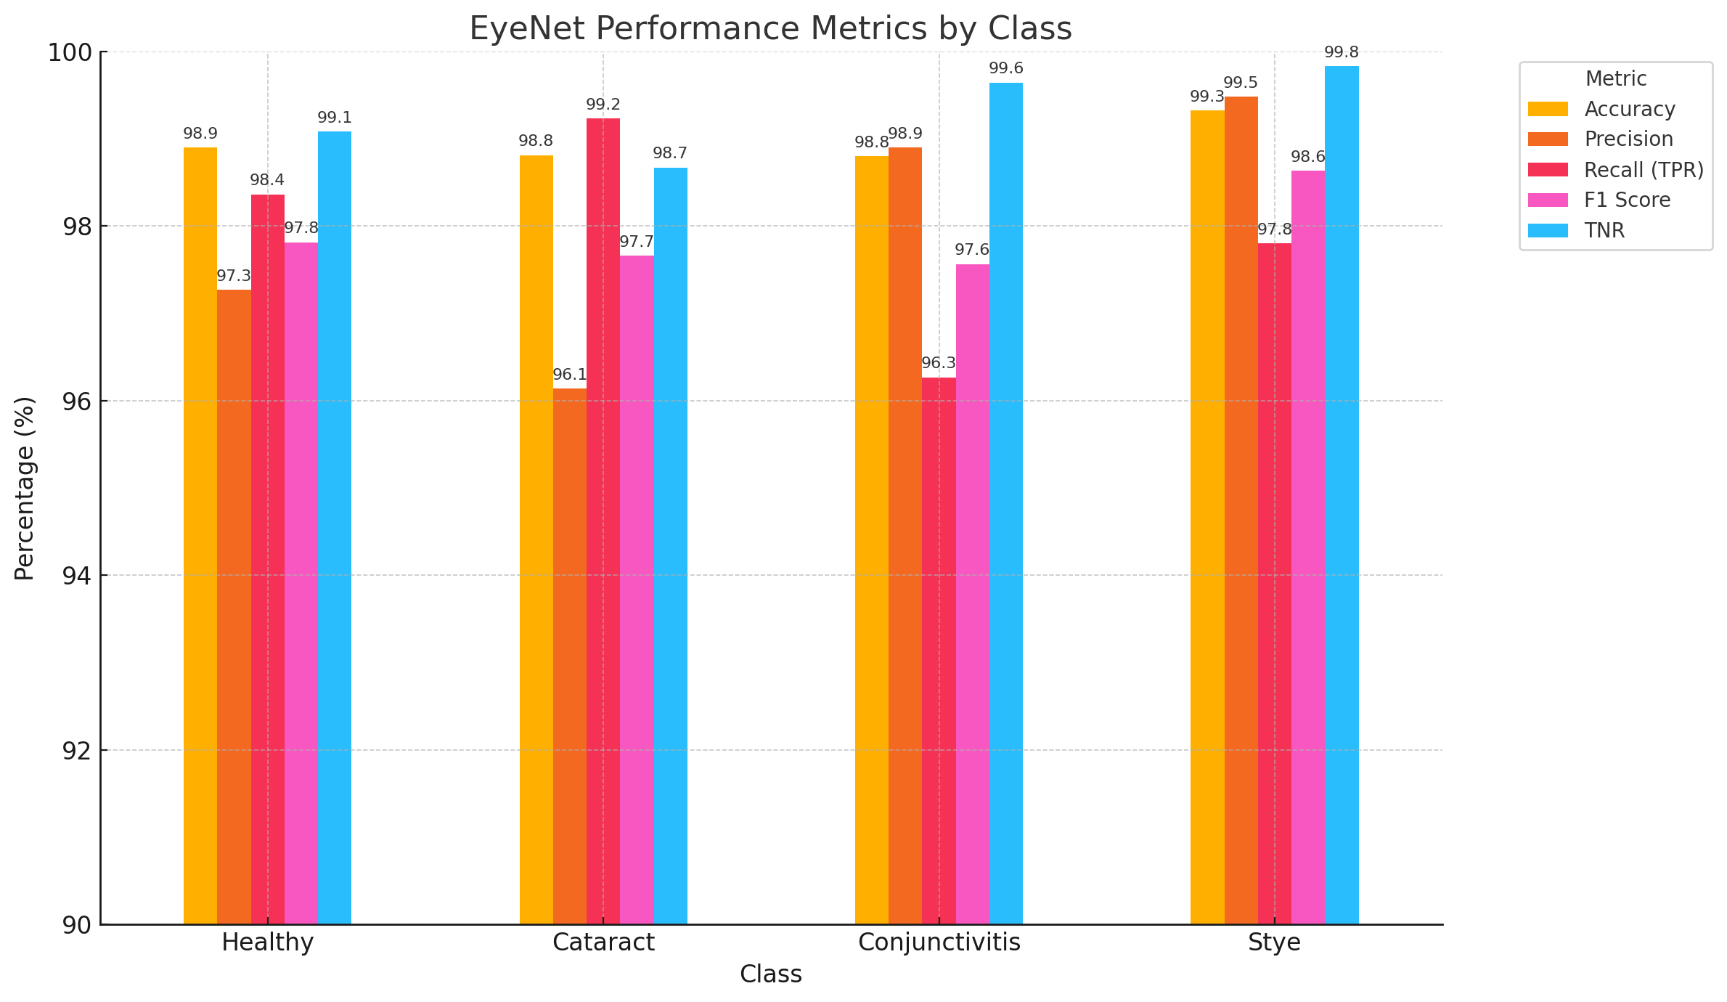
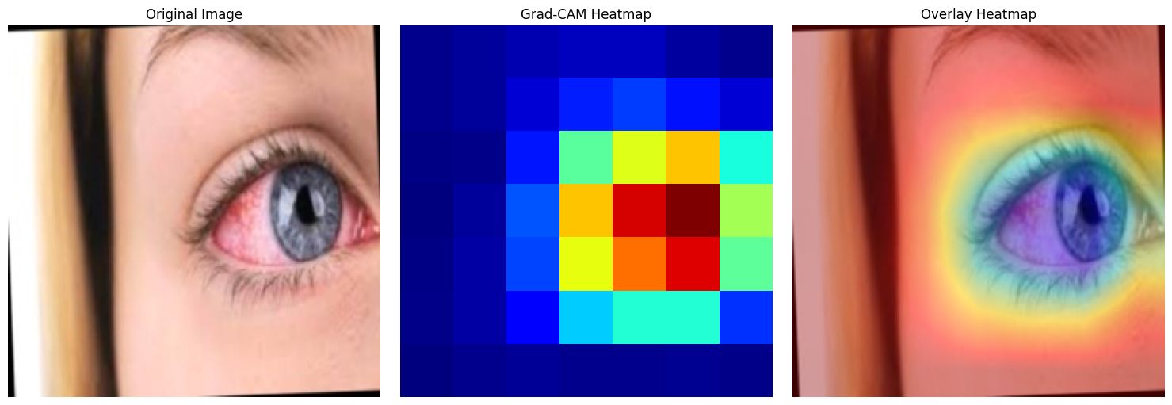
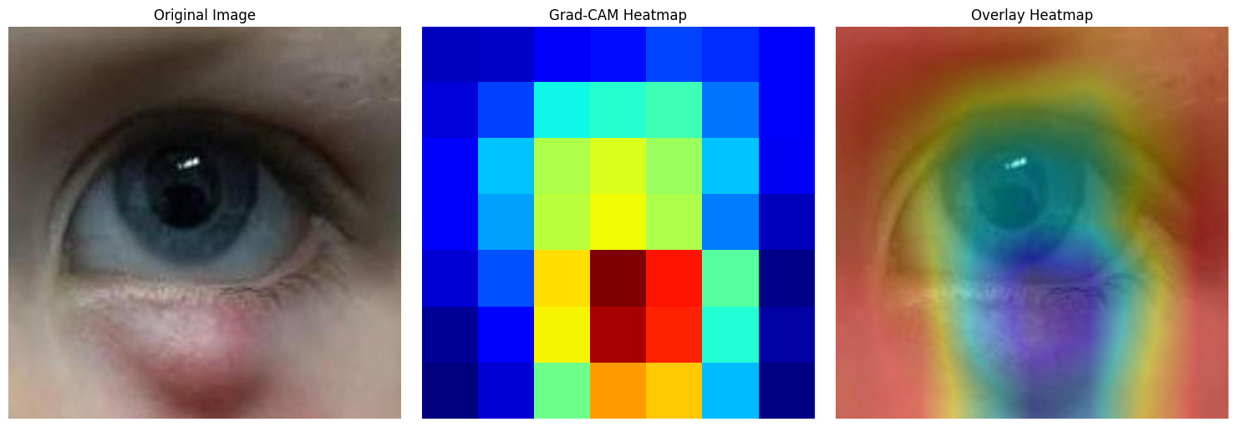

EyeNet
AI-Driven Early Eye Conditions Detection using Video Analysis
Eyes are a sensitive organ and exposed to infections and bacteria.
This leads to external eye diseases like:
Current Solutions
EyeNet
Feature
Face Detection | None | Retinal imaging only | Static image detection
Eye Condition Detection | Leukocoria only | Diabetic retinopathy | Cataracts, Dry Eyes
Input Type | Casual photos | Retinal images | Static images
User-Friendly Interface | Yes | Yes | Yes
Cost | Free | Paid | Varies
Scalability | Low | Moderate | Moderate
A deep learning-based system for identifying and classifying external eye conditions such as, Cataracts, Conjunctivitis, Styes.
Delivered as an end-to-end user-friendly web application. The core model is based on DenseNet121, enhanced with attention mechanism and trained of a dataset of over 13K images per class
Cataract
Conjunctivitis
Stye
Problems with current situation
Support both static (image) and dynamic (video) analysis
Accepts external image or video of face
Intuitive and easy for anyone to use
Free to use, accessible and cross-platform
Achieved ~98% accuracy in testing
No specialist equipment requires
Diagnosis is slow and expensive
Requires specialist equipment
Inaccessible in remote areas
Patients often diagnosed too late
Architecture
System Architecture Diagram
Pipeline Diagram
For snapshot or recorded video, the full pipeline is executed to detect and crop eye regions.
For uploaded images, we assume the client provides already-cropped eye images.
Results
The model learned to focus on the most relevant eye regions, improving accuracy from 91% to 98%. We believe a larger dataset could further enhance performance.
As we expected, cataract was the most challenging condition to classify, while stye achieved the highest and most consistent performance.
Students:
Gal Bitton
Ron Bendel
Supervisors:
Mrs. Elena Kremer
Dr. Dan Lemberg

